Slide 1


Welcome to Box Office Buddy

Slide 2
Box Office Buddy
Presented by:
Prathamesh Sawant
Sumit Karjule
Sumit Jagadale
Suraj Mundada

Slide 3
Area of Application
Movie Ticket Booking: Facilitates the reservation and purchase of movie tickets across various theaters, allowing users to select preferred showtimes, seats, and payment methods.
Movie Information :Provides detailed information on movies, including trailers, cast, and reviews..

Slide 4
Need Of System:
The BoxOfficeBuddy application is designed to streamline and enhance the movie-going experience by providing a centralized platform where users can discover movies, check showtimes, read reviews, and book tickets with ease.
It meets the need for convenience by offering real-time information and a seamless booking process. Additionally, BoxOfficeBuddy fosters a social experience through features like social sharing and group booking, while supporting local cinemas by increasing their visibility and offering special promotions.
The app also opens up monetization opportunities through targeted advertising, affiliate marketing, and premium features, all while providing valuable data insights for continuous improvement and scalability.
Ultimately, BoxOfficeBuddy simplifies the movie experience, making it more enjoyable and accessible for all users.

Slide 5
Buisness Use Cases
Admin
Theatre Owner
Customer

Slide 6
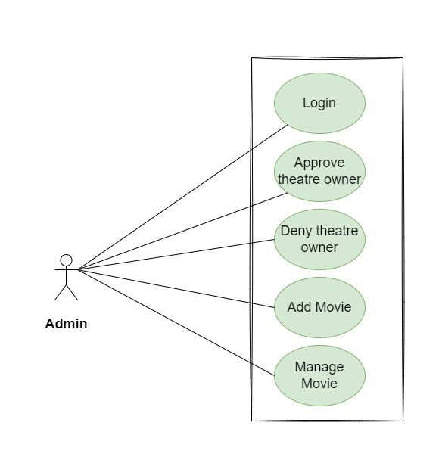
User Case: Admin:

Slide 7
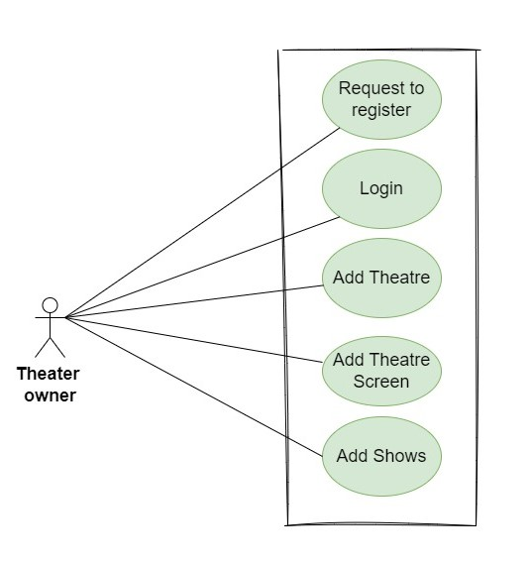
Use Case: Theatre Owner:

Slide 8
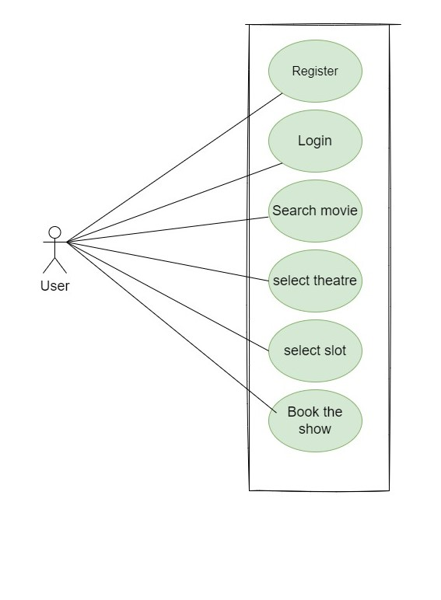
Use Case:- Customer :

Slide 9
Users and User Case
Admin
Login
2.Manage Movies
3.Manage Theater Owner

Slide 10
User And User Cases
Theater Owner
Register Login
Manage Shows
Upload Details View Feedback

Slide 11
User And User Case:
Customer
Register
Login
Search movies
Book ticket
View Booking History
Cancel Booking
Browse available shows
Give Feedback

Slide 12
Project Methdology
Phase 1:--
In phase one we have implemented Registration and Login for all Modules such as registration for
Custmer and Theatre Owner whereas Admin has only Login.
Phase 2:--
In phase two we have implemented all the CRUD operationssuch as add movie , delete movie, update the movie, view the movies ,manage theater ,book tickets and organize who booked
for the event.
Phase 3:-- In the third phase of our project, we introduced the implementation of transactions.
Transactions are essentially a way to ensure that multiple operations related to the booking process
either happen entire or don't happen at all. This is crucial for maintaining the integrity and consistency of data in our system

Slide 13
Git Hub Id
https://github.com/sumit1317v/Boxoffi ceBuddyproject.git

Slide 14
Testing Approach
Testing done at different tiers:
1.Rest API using postman.
2.Manual testing for react components

Slide 15
Future Extention
Personalized Recommendations: Analyze user preferences (genres,
timings, seats) to recommend suitable movies and showtimes.
Seamless Booking: Optimize the booking process for speed and efficiency, with features like auto-fill and saved payment details.
Event Ticketing: Expand to booking tickets for non-movie events like
concerts, plays, or stand-up comedy.

Slide 16
Thank you

